Slide 1
BLINKIT
DATA ANALYSIS

Slide 2
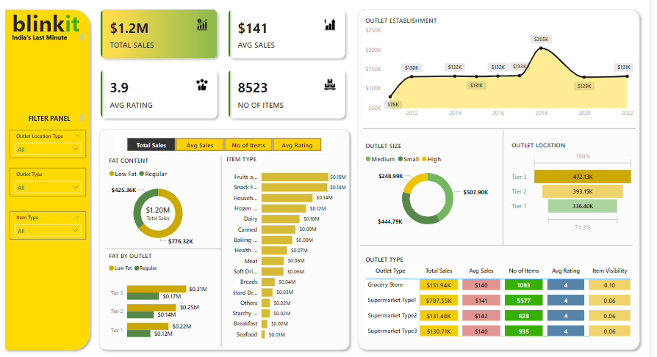

Slide 3
BUSINESS REQUIREMENT
KPI’s Requirements
Total Sales : The overall revenue generated from all items sold
Average Sales : The average revenue per sale
Number of Items : The total count of different items sold
Average Rating : The average customer rating of different items sold

Slide 4
BUSINESS REQUIREMENT
Chart’s Requirements
Fat Content by Outlet Type Establishment
Objective: Analyze how type of outlet and age of outlet influence Total sales
Chart Type : Bar Chart & Line Chart
Total Sales by Fat Content
Objective: Analyze how fat content influence Sales
Additional KPI metrics: Evaluate how other metrics like Average sales ,No of items and Average Rating Chart Type : Donut chart
Total Sales by Item Type
Objective: Identify Performance of different Item Type in terms of Total Sales
Additional KPI metrics: Evaluate how other metrics like Average sales ,No of items and Average Rating
Total Sales by Outlet Size and Outlet Location
Objective: Analyze Total sales by different Outlet Type and Outlet Location

